Slide 1

2805ICT System and Software Design 3815ICT Software Engineering 7805ICT Principles of Software Engineering
Lecture one: Software Engineering and Design Principles
Dr Larry Wen
Notes:
Right click on image
Select ‘Change Picture’
Choose your own photo and crop to suit the frame.

Slide 2
Contents
About me and the course
Java
Introduction of Java
Jshell
Expressions & statements
Primitive data types
Wrapper classes and pooling
Method basics
Software Engineering
What is Software Engineering
Software Development Life Cycle
Cohesion & Coupling
Git/GitHub basics: repo setup, commits, push/pull

Slide 3

About Me
Larry
Name: Dr Larry Wen
Office: N44 2.32 (Nathan campus)
Phone: 55042
Email: l.wen@griffith.edu.au
Contact me in Teams
I like to be your friend and my duty is to help you to learn.

Slide 4
Assessment plan
Assignment milestone 1
Weight:20%
Group or individual (need to be approved if work as individual)
Due: end of Friday in week 5 (22/08/2025)
Assignment final submission
Weight: 40%
Group or individual (same setting as milestone 1)
Due: end of Friday in week 11 (03/10/2025)
Final exam
Weight: 40%
Individual, two hours
Close book (with notes)

Slide 5
About group
Labs are not assessed, so students are free to complete the exercises individually or collaborate with peers.
The assignment is group-based, with up to five students per group.
Students who wish to work individually must contact me for approval. If approved, they will still need to register in a group for administrative tracking.
Mixed groups (across different course codes or lab sessions) are allowed.
Only one group member needs to submit the assignment on behalf of the entire group.
Although assignments are submitted as a group, individual marks may vary based on contributions and peer reviews (details in the assignment spec).
⚠️ The assignments are designed for teamwork. Completing them solo is highly challenging. Many students who worked alone last year regretted the decision.

Slide 6
Contents
About me and the course
Java
Introduction of Java
Jshell
Expressions & statements
Primitive data types
Wrapper classes and pooling
Method basics
Software Engineering
What is Software Engineering
Software Development Life Cycle
Cohesion & Coupling
Git/GitHub basics: repo setup, commits, push/pull

Slide 7
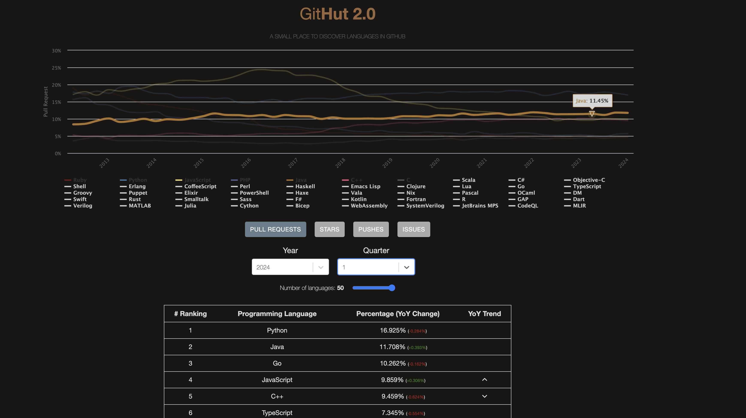
Why Java

Slide 8


Introduction to Java
What is Java?
A high-level, object-oriented programming language.
Created by James Gosling and the Green Team at Sun Microsystems in 1991, first released in 1995.
Known for its "write once, run anywhere" capability.
Key Features:
Platform Independent: Runs on any device with a Java Virtual Machine (JVM).
Object-Oriented: Promotes modular, reusable code.
Robust and Secure: Strong memory management, exception handling, and security features.

Slide 9
Evolution of Java
Early Development (1990-1995):
Initially called "Oak," aimed for consumer electronics.
Renamed "Java" in 1995, released with JDK 1.0.
Major Releases:
Java 2 (1998): Introduced Swing, Collections Framework.
Java 5 (2004): Added generics, annotations, and enhanced for-loop.
Java 8 (2014): Introduced lambda expressions, Stream API, new date-time API.
Java 11 (2018): Long-Term Support (LTS) version with new HTTP client, local-variable syntax.
Java 21 (2023): Latest LTS release with advanced features and enhancements.

Slide 10






Java in Today's World
Usage and Popularity:
Widely used in enterprise applications, web development, and mobile apps.
Dominant language for Android development.
Strong presence in big data technologies (Hadoop, Spark).
Community and Support:
Large and active developer community.
Extensive libraries and frameworks (Spring, Hibernate).
Continuous improvement with a regular release schedule.

Slide 11
Which Version of Java
What is the Java LTS?
Oracle, the "owners" of Java, release Java updates a few times a year.
Special ones are designated "Long-Term Support", or LTS.
Regular releases are only supported for six months.
LTS versions, on the other hand, receive extended security updates, bug fixes, and patches for years.
As a result, LTS releases are your rock-solid choice, especially for production environments and when learning Java.

Slide 12
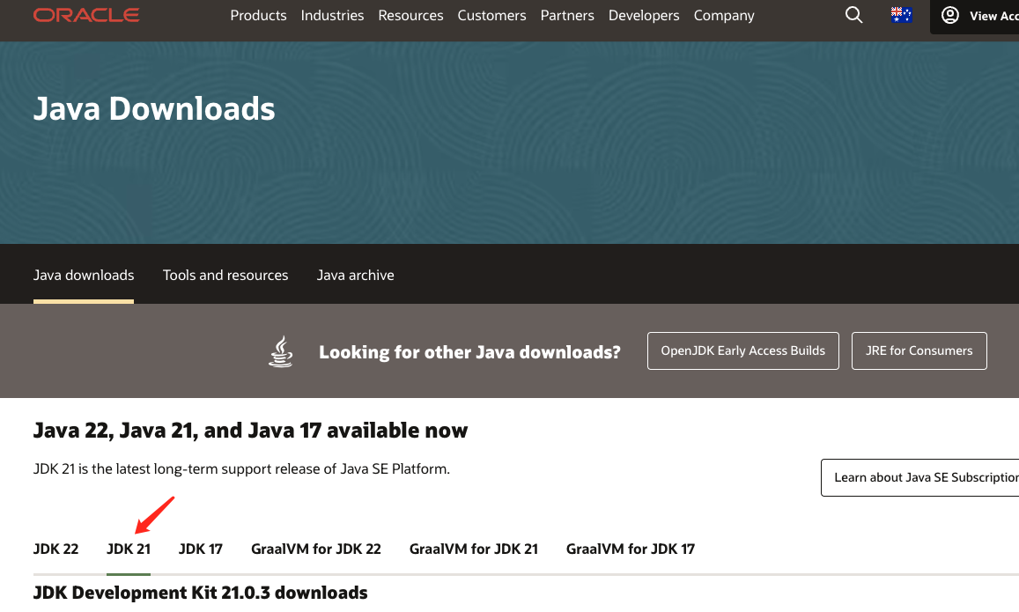
Install Java 21 (web page)
Goto Oracle Java download page https://www.oracle.com/au/java/technologies/downloads/
Select Java 21

Slide 13
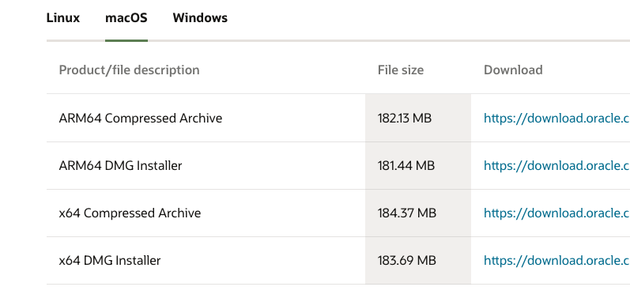
Install Java – select operation system
Based on your computer, select the right installer.

Slide 14
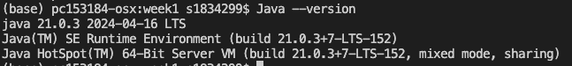
Verify installation
After installation, verify it with `java –version`

Slide 15
Contents
About me and the course
Java
Introduction of Java
Jshell
Expressions & statements
Primitive data types
Wrapper classes and pooling
Method basics
Software Engineering
What is Software Engineering
Software Development Life Cycle
Cohesion & Coupling
Git/GitHub basics: repo setup, commits, push/pull

Slide 16
JShell
JShell became a standard component of the Java Developers Kit in Java 9.
It is what is known as a Read-Eval-Print-Loop interactive program (or REPL for short) which means it does pretty much just that:
it reads the command or code segment we type in.
it evaluates and executes the code, and often allows short cuts to be used.
it prints out the results of the evaluation or execution, without making the developer write code to output the results.
Lastly, it loops right back for more input (more code segments or commands).
JShell runs in a terminal (or on the command line for Windows) and is useful for quickly trying out new ideas.

Slide 17
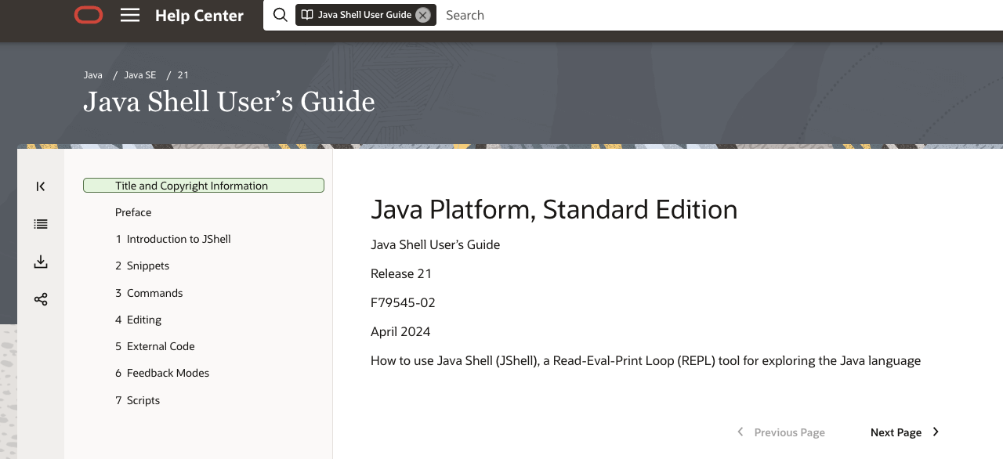
JShell Website
Web url: https://docs.oracle.com/en/java/javase/21/jshell/

Slide 18
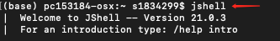
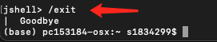
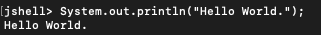
Using JShell
Get into jshell by typing `jshell` in terminal.
Exit jshell by type `/exit`
Hello World with jshell

Slide 19
Contents
About me and the course
Java
Introduction of Java
Jshell & IntelliJ setup
Primitive data types
Wrapper classes and pooling
Expressions & statements
Method basics
Software Engineering
What is Software Engineering
Software Development Life Cycle
Cohesion & Coupling
Git/GitHub basics: repo setup, commits, push/pull

Slide 20
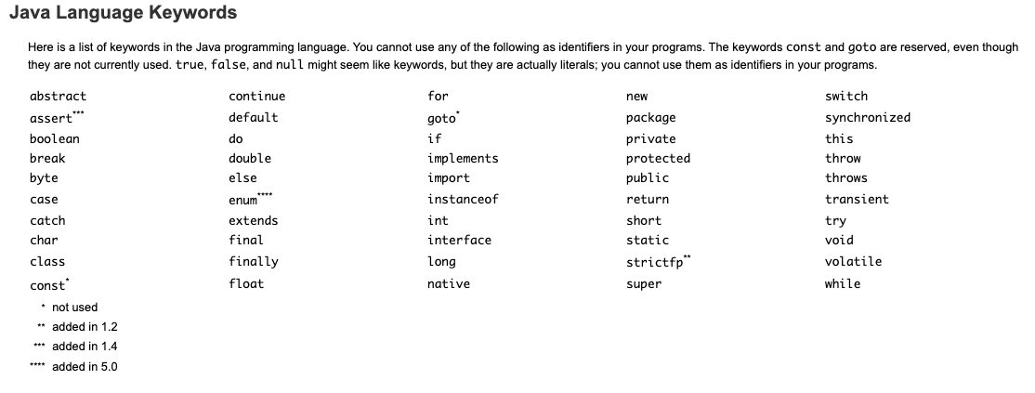
Keywords
Keywords are reserved words by Java language.

Slide 21
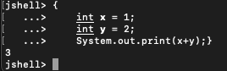
Variables
Variables that we define in a program, can be accessed by a name we give them.
In the example above, `int` is a keyword, `x` and `y` are two variables, they are integers declared by keyword `int`.

Slide 22
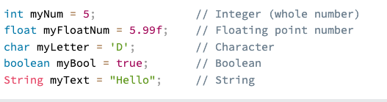
Data Types
Common data types in Java:
In Java, there are two different groups of data types
Primitive data types (value type)
Objects (reference type)

Slide 23
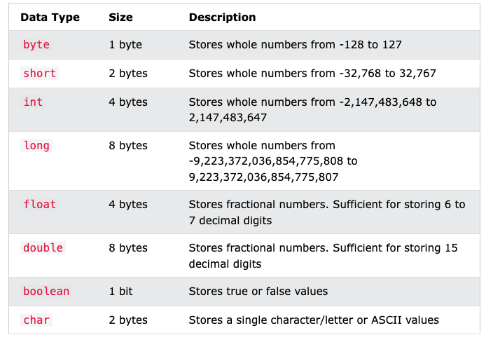
Primitive Data Types
List of primitive data types

Slide 24
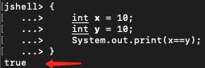
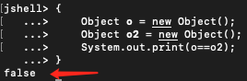
Primitive Data Type Are Value-Based.
When using `==` to compare for variables of primitive data type, their values are compared.
Objects are compared by instances, not values.

Slide 25
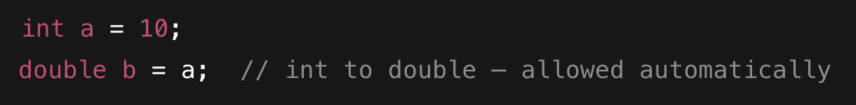
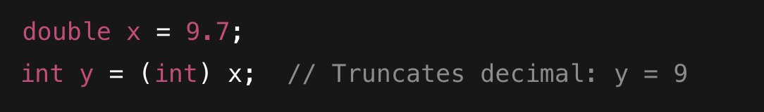
Type Casting
Type casting means converting a value from one data type to another.
Implicit Casting (Widening)
Explicit Casting (Narrowing)
Narrowing conversions can lose data or precision, use explicit casting carefully when converting types.

Slide 26
Contents
About me and the course
Java
Introduction of Java
Jshell
Primitive data types
Wrapper classes and pooling
Expressions & statements
Method basics
Software Engineering
What is Software Engineering
Software Development Life Cycle
Cohesion & Coupling
Git/GitHub basics: repo setup, commits, push/pull

Slide 27
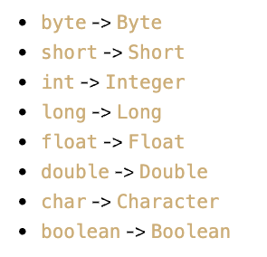
Wrapper Classes
Each primitive data type has an associated wrapper class.
The major purpose to have wrapper class is that in some of Java operations, they require objects, for example a collection of something, therefore, they introduce wrapper classes.

Slide 28
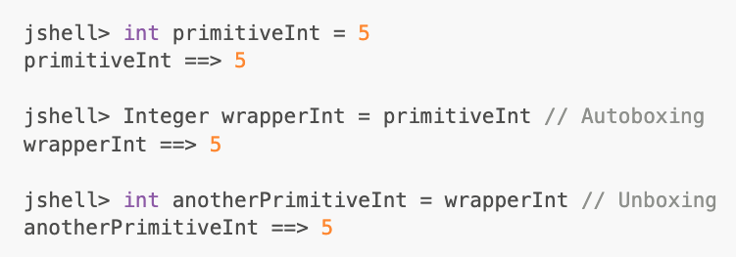
Autoboxing and Unboxing
Autoboxing: Automatic conversion of a primitive type to its corresponding wrapper class.
Unboxing: Automatic conversion of a wrapper class to its corresponding primitive type.

Slide 29
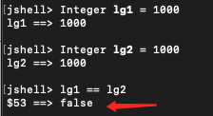
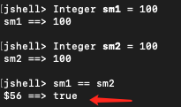
Integer Pooling
Integer is a reference type, not a primitive.
So, comparing two Integer objects with == usually checks reference equality, not value.
However, Java caches Integer objects in a specific range to improve performance:
✅ Integer values from -128 to 127 are pooled.
Always use .equals() to compare object values.
Pooling improves memory efficiency and speed for commonly used values.

Slide 30
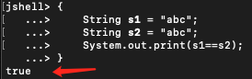
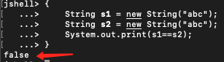
String Pooling
When strings are declared literally (e.g., "hello"), they are stored in a shared String Pool. If two literal strings have the same value, they point to the same object:
However, if a string is created using new String(), a new object is allocated on the heap:

Slide 31
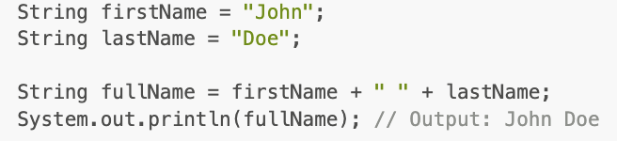
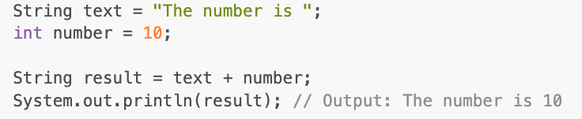
String Concatenation with +
Use + to concatenate two strings or a string with other variables.

Slide 32
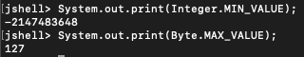
Number data type: MIN_VALUE and MAX_VALUE
Each number data type is associated with a wrapper class, for example int => Integer, byte => Byte
We can find the maximum and minimum value of some primitive data type through MIN_VALUE and MAX_VALUE

Slide 33
Contents
About me and the course
Java
Introduction of Java
Jshell
Primitive data types
Wrapper classes and pooling
Expressions & statements
Method basics
Software Engineering
What is Software Engineering
Software Development Life Cycle
Cohesion & Coupling
Git/GitHub basics: repo setup, commits, push/pull

Slide 34
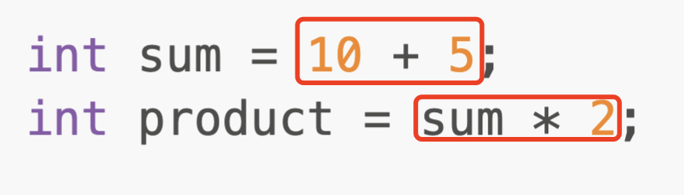
Java Expressions
An expression in Java is a construct that evaluates to a single value. Expressions can be as simple as a single constant or variable, or as complex as a combination of variables, operators, method calls, and other expressions.
Expression examples

Slide 35
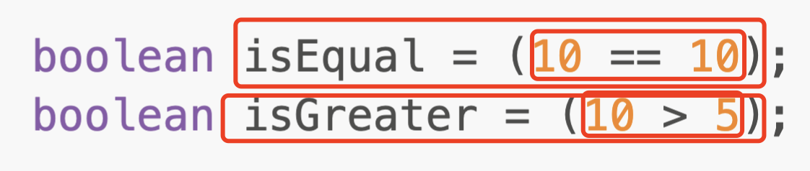
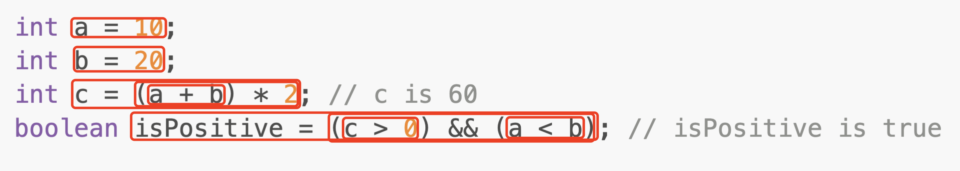
More Expression Example
One statement can contain multiple expressions:
Each box is an expression:
Expression doesn’t contain the semi-column and the type keyword.

Slide 36
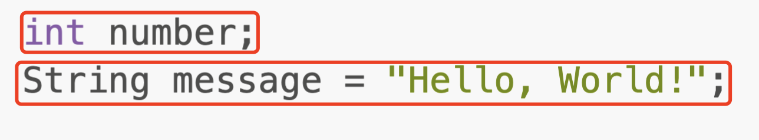
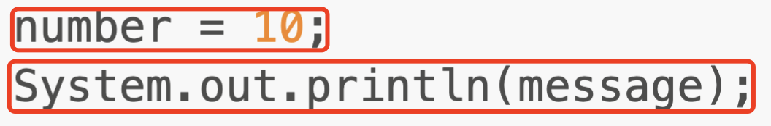
Statements
A statement in Java is a complete unit of execution. Statements are executed in sequence and can control the flow of the program.
Declaration statements:
Expression statements:

Slide 37
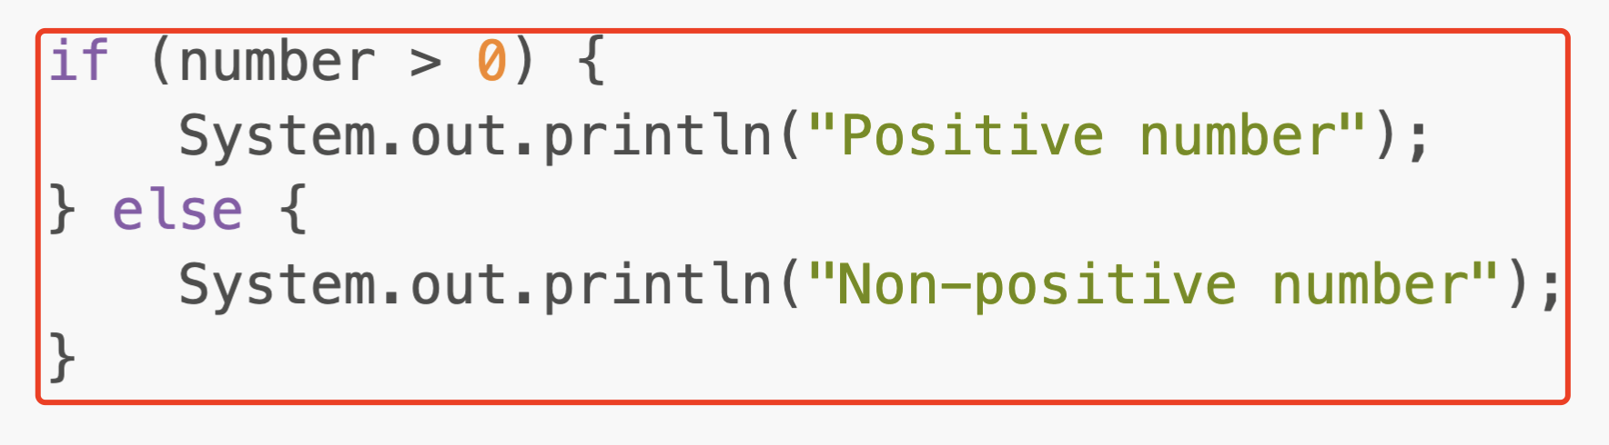
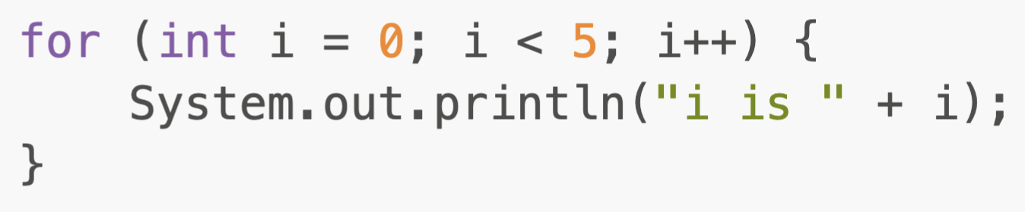
More examples
Conditional statements
Loop statements:

Slide 38
Contents
About me and the course
Java
Introduction of Java
Jshell
Primitive data types
Wrapper classes and pooling
Expressions & statements
Method basics
Software Engineering
What is Software Engineering
Software Development Life Cycle
Cohesion & Coupling
Git/GitHub basics: repo setup, commits, push/pull

Slide 39
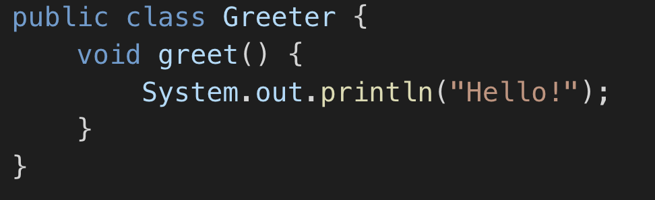
Method Basics – What is a Method?
In Java, all methods must be defined inside a class.
A method is a reusable block of code that performs a task.
Methods improve modularity, readability, and maintainability.
Types:
Predefined (e.g., System.out.println())
User-defined (created by the programmer)

Slide 40
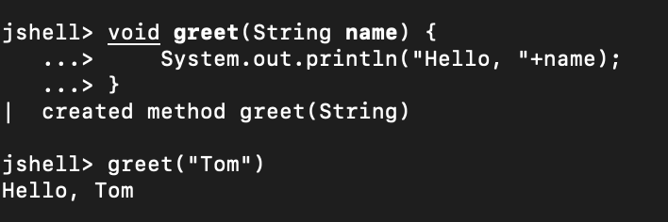
Why Methods Must Be in Classes
Java is a class-based object-oriented language
Methods cannot exist outside a class in standard Java files
⚠️ Exception: In JShell, you can write methods outside classes because JShell wraps them automatically

Slide 41
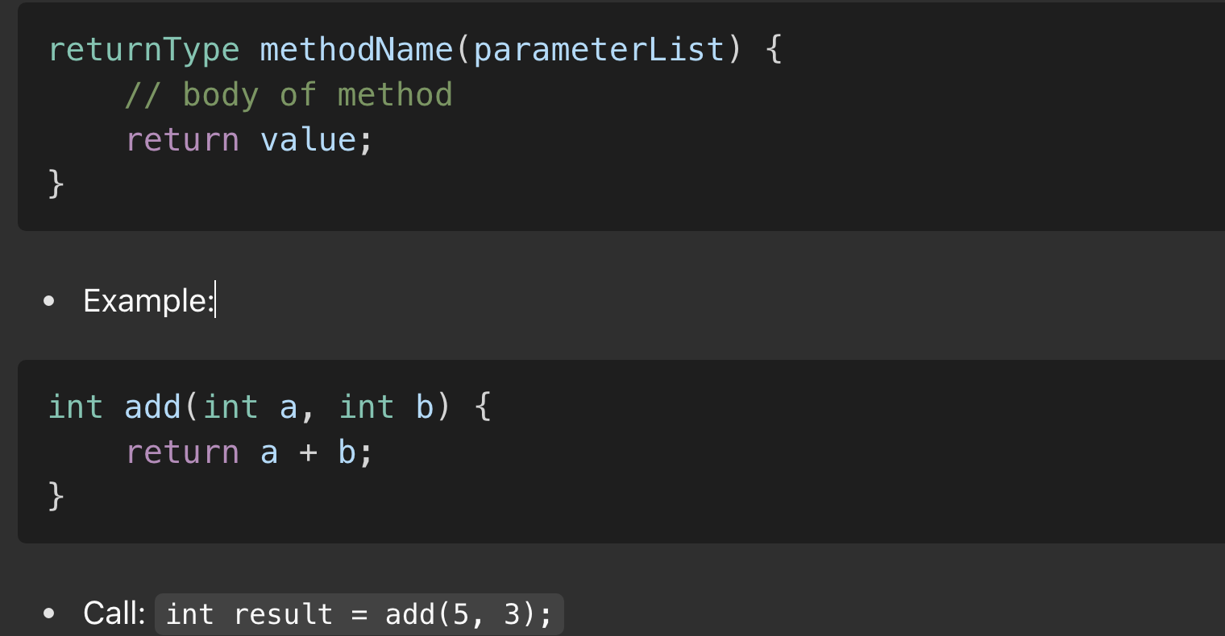
Method Syntax and Structure

Slide 42
Contents
About me and the course
Java
Introduction of Java
Jshell
Primitive data types
Wrapper classes and pooling
Expressions & statements
Method basics
Software Engineering
What is Software Engineering
Software Development Life Cycle
Cohesion & Coupling
Git/GitHub basics: repo setup, commits, push/pull

Slide 43
What is Software
Software is:
instructions (computer programs) that when executed provide desired features, function, and performance;
data (in) structures that enable the programs to adequately manipulate information and
documentation that describes the operation and use of the programs.

Slide 44
Software is Special
Developed or engineered, not manufactured
Software doesn't "wear out."
custom-built.

Slide 45
Wear vs. Deteroration

Slide 46
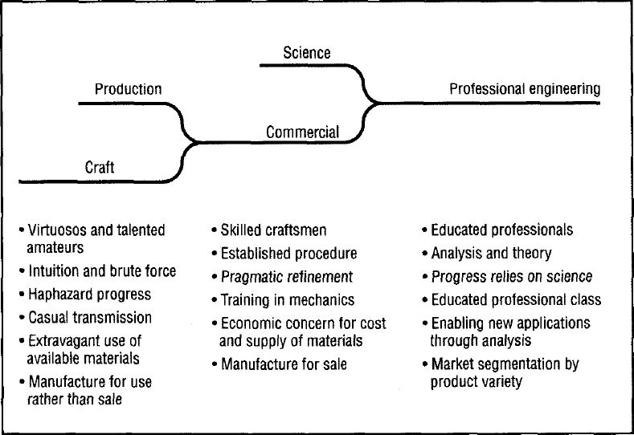
What is Engineering

Slide 47
Properties of Engineering
Large scale
Quality
Commercial (market)
Cost effective (profit)
Practical
Management and human issue
Standards and regulation

Slide 48
Software Engineering
IEEE definition
the application of a systematic, disciplined, quantifiable approach to the development, operation, and maintenance of software, and
the study of these approaches; that is, the application of engineering to software.

Slide 49
What is Software Engineering

Slide 50
Factors Affecting the Quality of a Software System
Complexity:
The system is so complex that no single programmer can understand it anymore
The introduction of one bug fix causes another bug
Change:
The “Entropy” of a software system increases with each change: Each implemented change erodes the structure of the system which makes the next change even more expensive (“Second Law of Software Dynamics”).
As time goes on, the cost to implement a change will be too high, and the system will then be unable to support its intended task. This is true of all systems, independent of their application domain or technological base. (eventually a system will die)

Slide 51
Contents
About me and the course
Java
Introduction of Java
Jshell
Primitive data types
Wrapper classes and pooling
Expressions & statements
Method basics
Software Engineering
What is Software Engineering
Software Development Life Cycle
Cohesion & Coupling
Git/GitHub basics: repo setup, commits, push/pull

Slide 52
Common Software Lifecycle Activities
Requirements
Elicitation
Analysis
System
Design
Object
Design
Implemen-
tation
Testing
Implemented
By
Expressed in Terms Of
Verified
By
Structured By
Realized By
class...
class...
class...
?
class....
?
Use Case
Model
Application
Domain
Objects
Solution Domain
Objects
Subsystems
Source
Code
Test
Cases

Slide 53
Simplified Software Process
Feasibility and
Planning
Requirements
Design
Operation and
Maintenance
Implementation

Slide 54
Waterfall Model

Slide 55
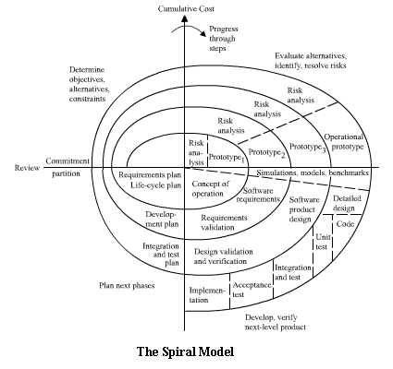
Spiral Model

Slide 56
Other Lifecycle Model
Prototyping
Iteration
V model
W model
Agile approaches

Slide 57
Contents
About me and the course
Java
Introduction of Java
Jshell
Primitive data types
Wrapper classes and pooling
Expressions & statements
Method basics
Software Engineering
What is Software Engineering
Software Development Life Cycle
Cohesion & Coupling
Git/GitHub basics: repo setup, commits, push/pull

Slide 58
Within & Without
Object oriented analysis and design is essential about building systems with high degrees of cohesion (within) and low amount of coupling (without).
Cohesion – The degree to which elements of a component or object inter-depend.
Coupling - The degree to which components or objects depend on one another.
Generally loose coupling is desirable for good software engineering.
Finding a balance between what to put into an object, component or module is the essence of design.

Slide 59
Design Principles – Cohesion and Coupling
Cohesion:
A measure of how closely related the responsibilities of a module are
High cohesion = better maintainability
Coupling:
Degree of interdependence between modules
Low coupling = easier to modify/test independently

Slide 60
Explain Cohesion in Plain English
In a well-managed shopping center:
Various types of breads are put in one shell.
Milk might be placed close to breads.
Food in one section and tools are in another section.
This kind of arrangement is also recommended for software project.

Slide 61


Visualize Cohesion
High cohesion looks like:
Low cohesion looks like:

Slide 62
Module Coupling
Coupling is the measure of the degree of interdependence between modules.
No coupling
loosely coupled
Some dependencies
Highly coupled
Many dependencies

Slide 63
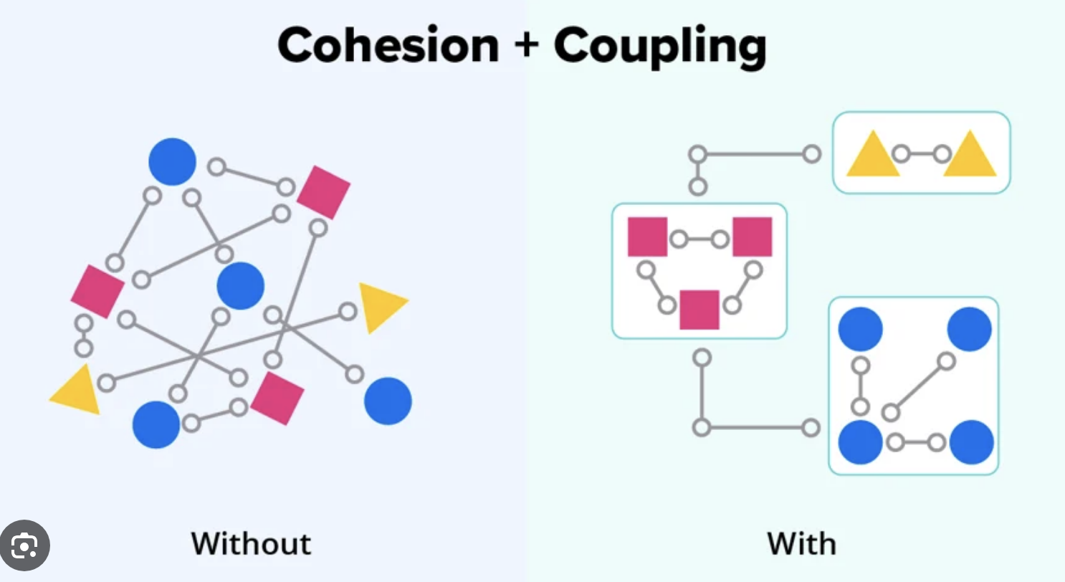
Cohesion + Coupling

Slide 64
Contents
About me and the course
Java
Introduction of Java
Jshell
Primitive data types
Wrapper classes and pooling
Expressions & statements
Method basics
Software Engineering
What is Software Engineering
Software Development Life Cycle
Cohesion & Coupling
Git/GitHub basics: repo setup, commits, push/pull

Slide 65
Introduction to Git and GitHub
Git:
Local version control tool
Commands:
git init, git add, git commit, git status, git log
GitHub:
Cloud platform to host and collaborate on Git repositories
Best practices:
Commit often, write meaningful messages
Use .gitignore to avoid clutter

Slide 66
Git Workflow
Typical workflow:
Clone a repository: git clone
Create a new branch: git checkout -b feature-x
Make changes and commit
Push to GitHub: git push origin feature-x
Submit a pull request
Collaboration through branches, issues, and pull requests

Slide 67
Questions

Slide 68
THANK YOU

